Slide 1
Update on COVID-19
26 February 2020

Slide 2
Current Situation (as of 26 Feb, 6AM Geneva time)
Updates from last 24 hours
China
411 new confirmed cases: 98% from Hubei
52 new deaths (Hubei)
439 new suspected cases
Outside China
427 new confirmed cases: Republic of Korea(253), Italy(93), Islamic Republic of Iran(34), Bahrain(15), Japan(8), Kuwait(6), Iraq(4), Germany(3), Thailand(2), Oman(2), Austria(2), Switzerland(1), Singapore(1), Croatia(1), Australia(1), Algeria(1)
12 new deaths: Italy (5), Iran (Islamic Republic of) (3), Republic of Korea (3), International conveyance (Diamond Princess) (1)
Between 31 Dec 2019 - 26 Feb 2020
80,980 confirmed cases
2,762 deaths
China
78,190 confirmed cases
8,752 severe cases
2,718 deaths (96% Hubei)
Outside China
2,790 cases from 37 countries
44 deaths: Iran (Islamic Republic of) (15), Republic of Korea(11), Italy(11), International conveyance (Diamond Princess)(4), Philippines(1), Japan(1), France(1)

Slide 3
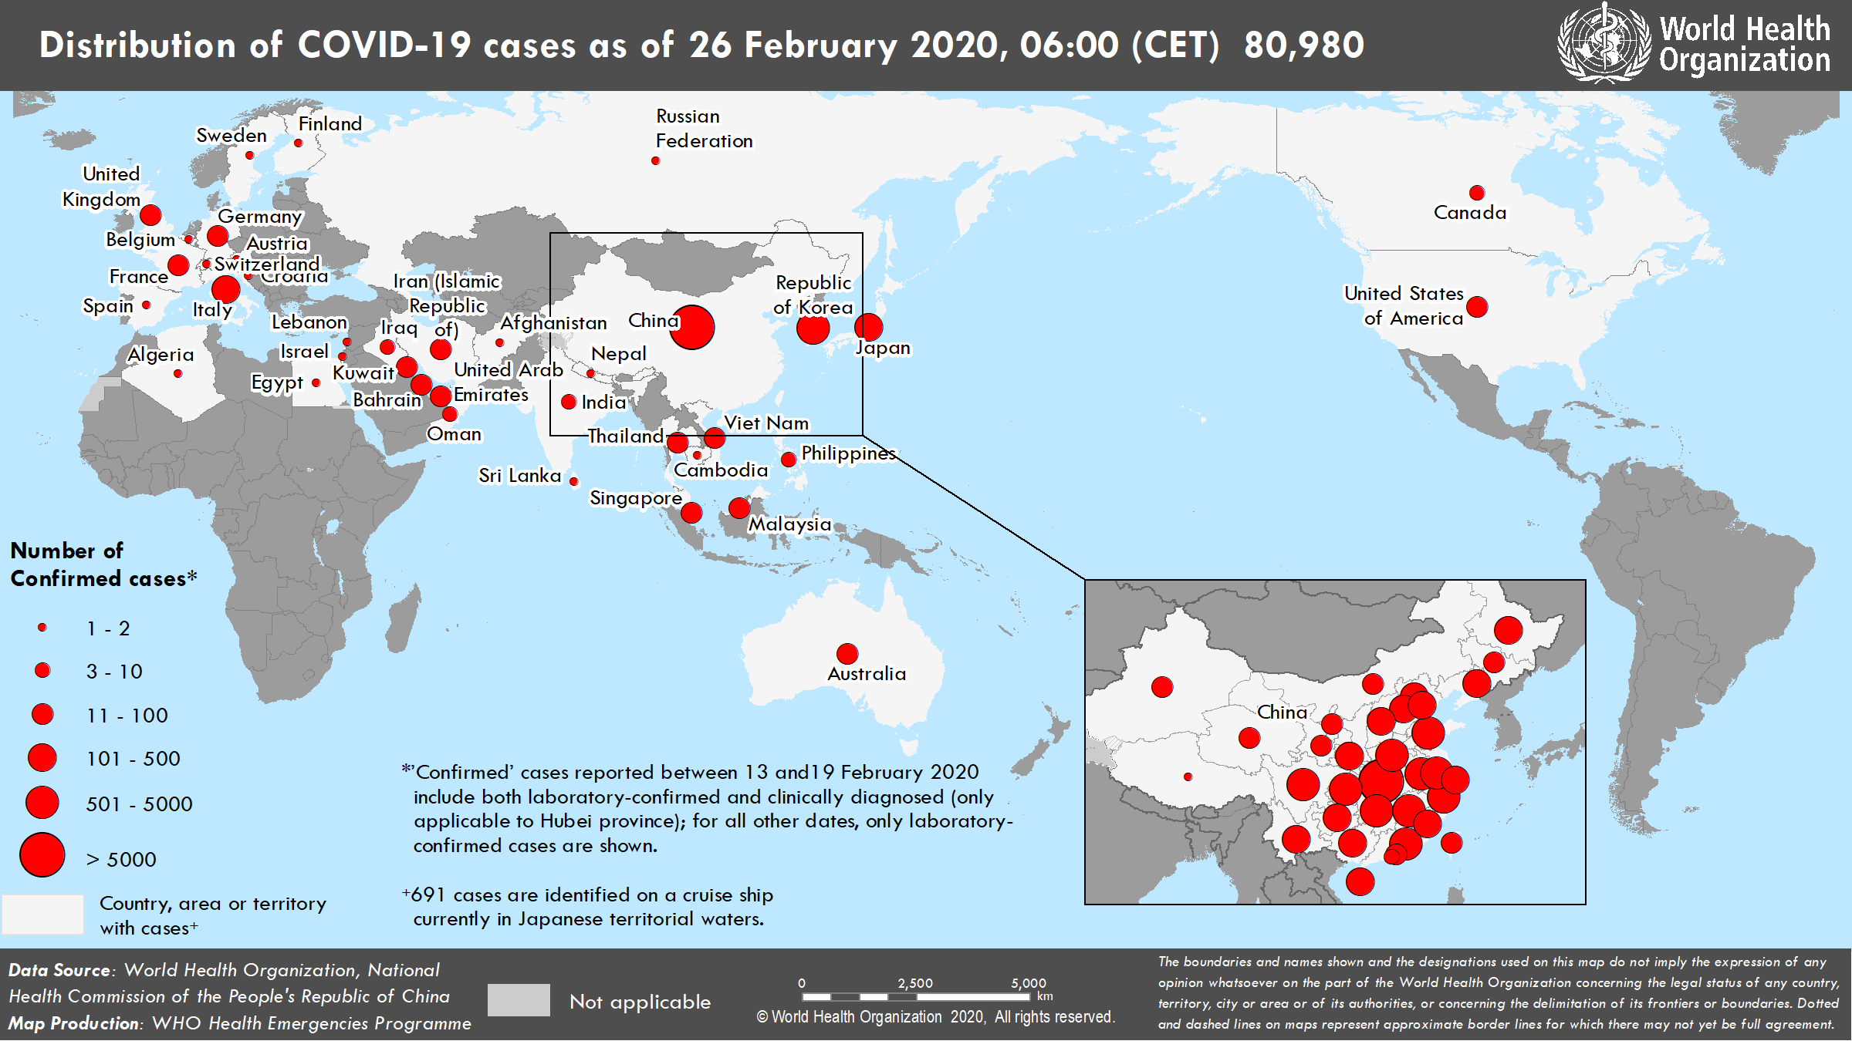

Slide 4
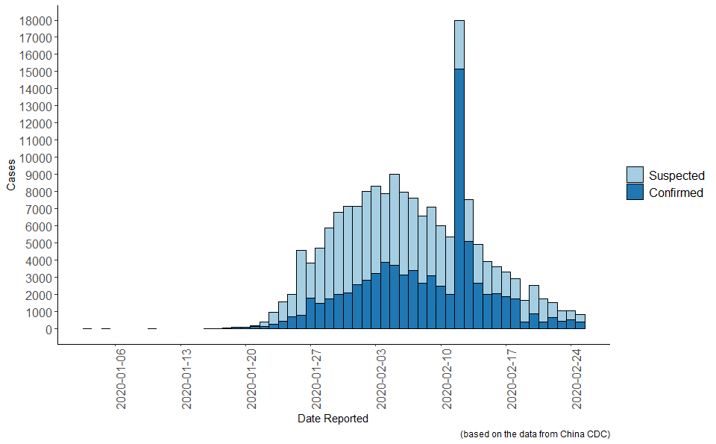
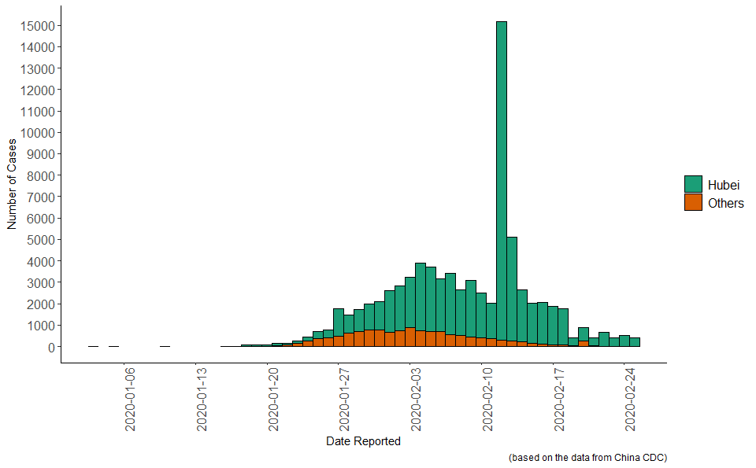
Cases in China by Report Date
Suspected and confirmed cases
Confirmed cases (Hubei province vs. others)

Slide 5
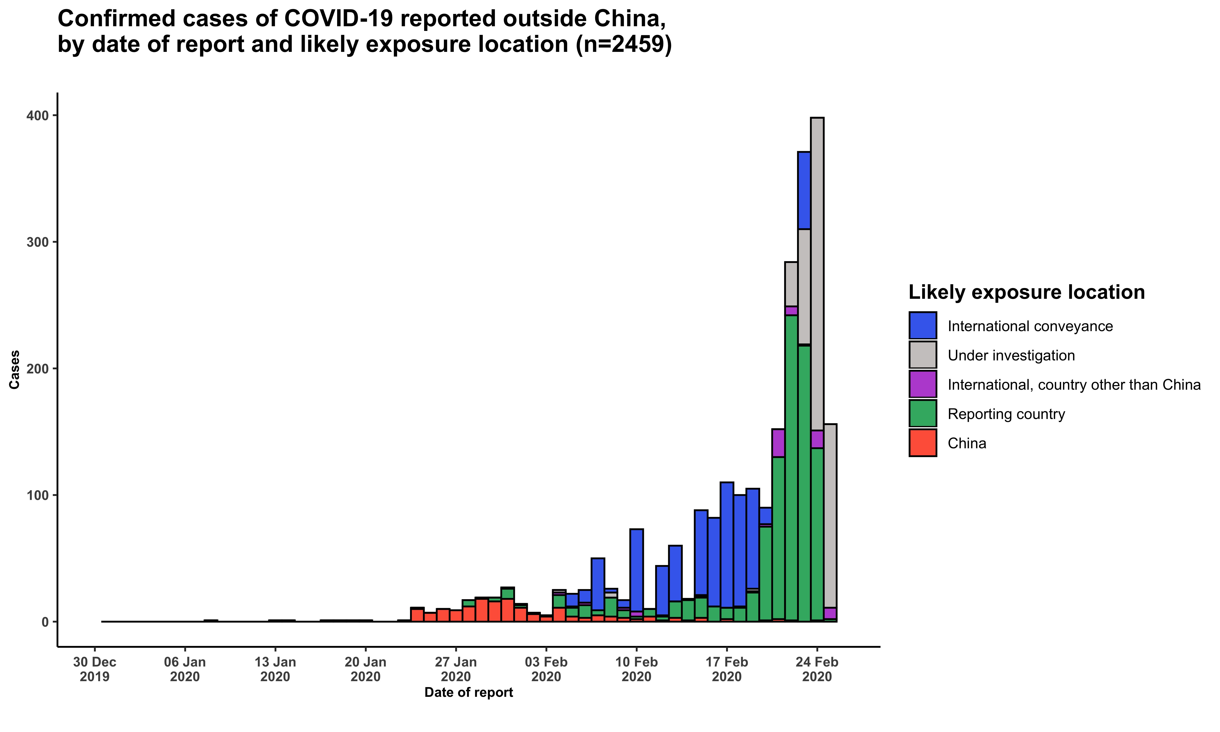
Cases outside China by date of notification

Slide 6
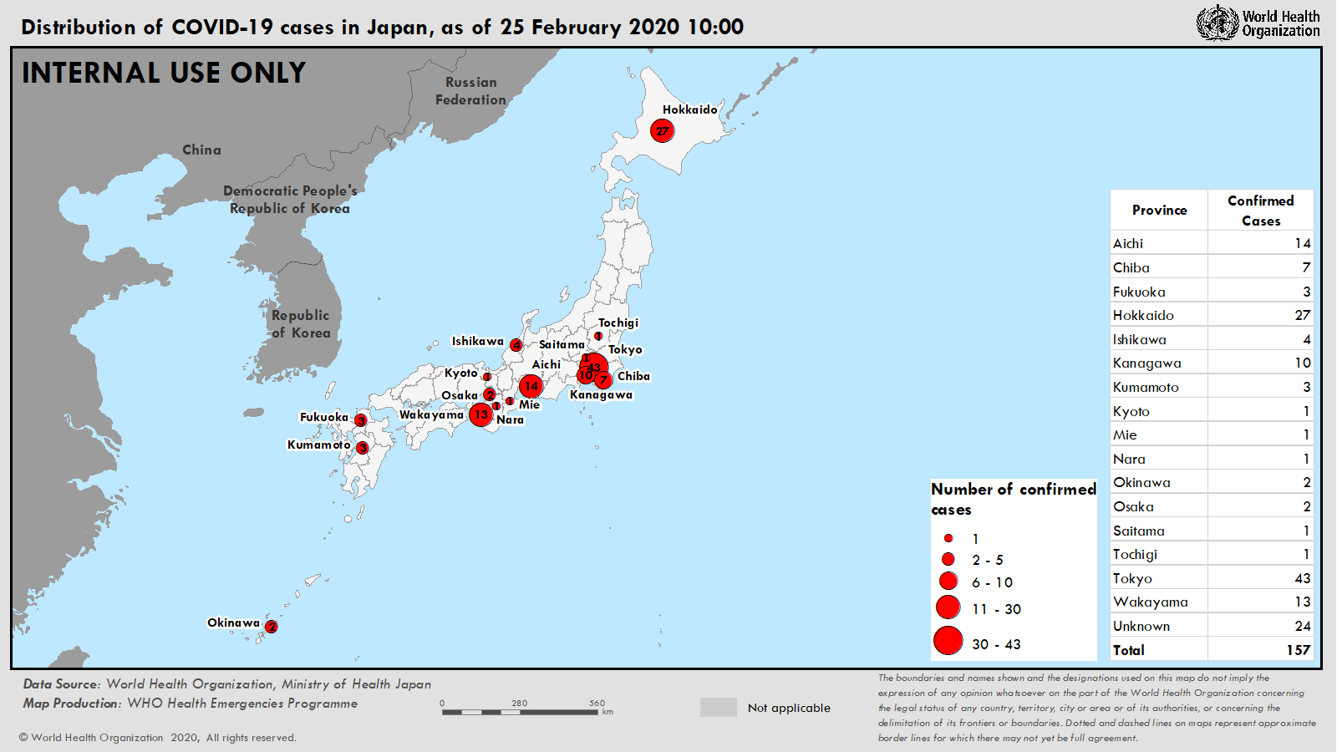

Slide 7
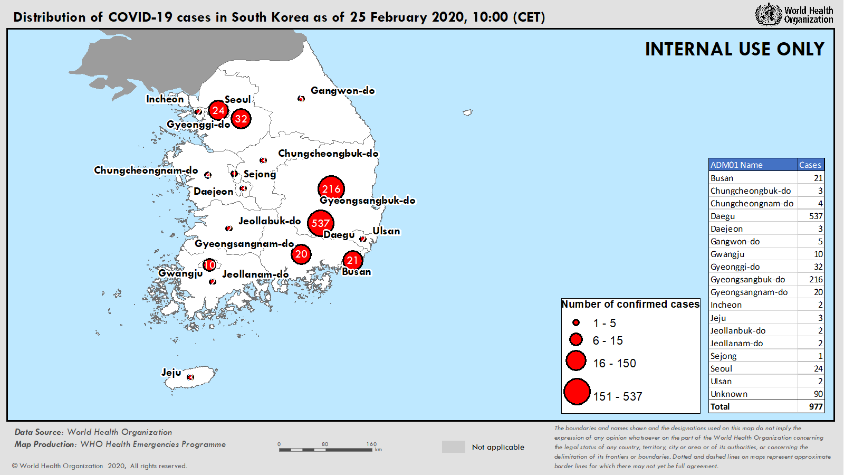

Slide 8
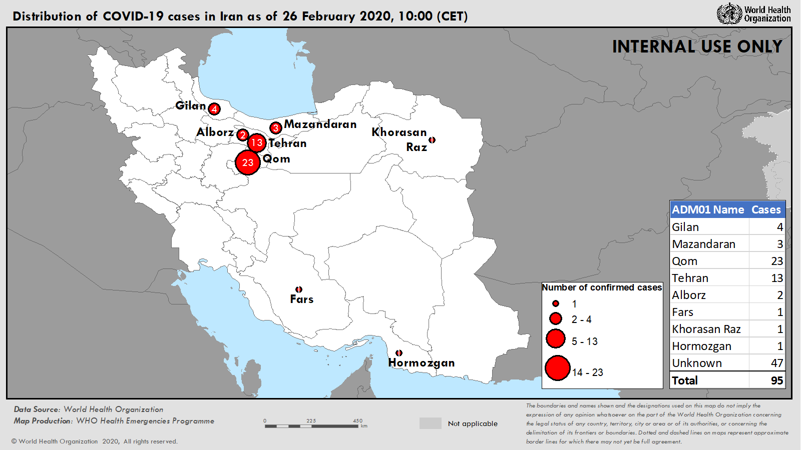

Slide 9
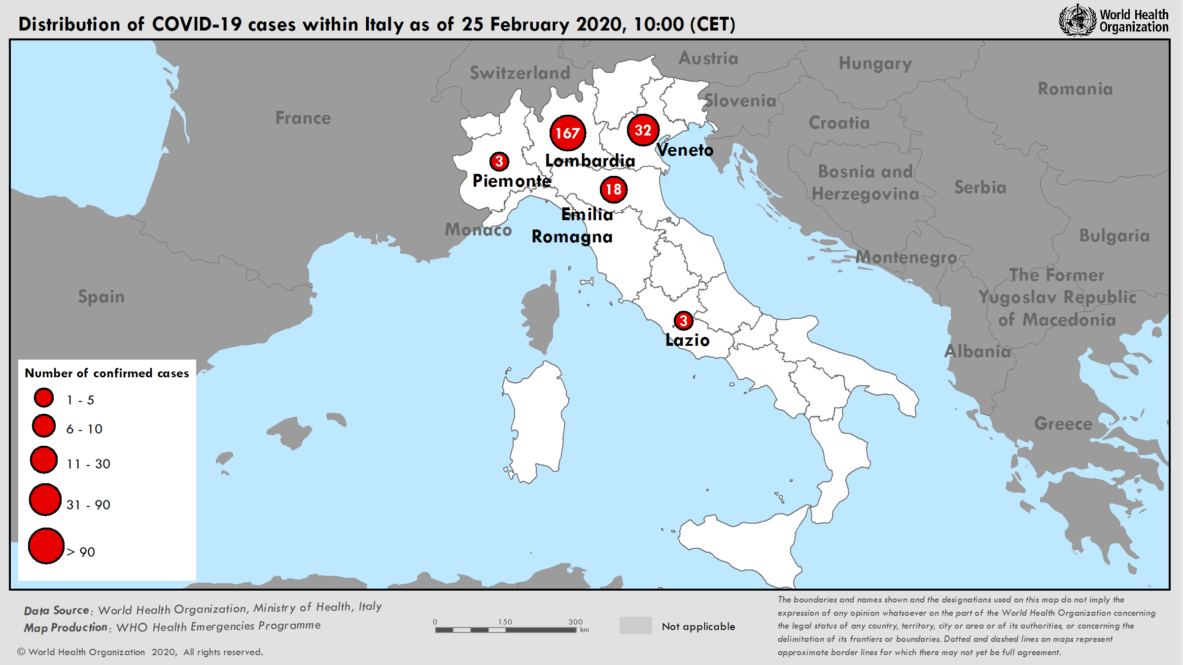

Slide 10
Official reports about travel measures (as of 25 Feb)
Notes:
34 State Parties officially reporting additional health measures that significantly interfere with international traffic under IHR (as of February 24).
45% of measures relate to denial of entry to travelers from China, followed by quarantine requirements of foreigners, self-isolation of returning nationals, and visa restrictions.
58% of public health rationale linked mostly to vulnerabilities in receiving countries (lack of capacity for diagnostics and response, small island context), and unknowns about the virus and disease.
No trade restrictions reported so far

Slide 11
Effects of COVID-19 on global supply chains
Concentration of manufacturing industries and supply chain operations in one region has led to unprecedented restriction on supply capacity
Severe consequences on health sector and responders, including limited to no access to purchase PPE
Additional repercussions
Increased prices (5-20x)
Labour shortages affecting manufacturing capacity
Government export restrictions disrupting logistics chains
Potential missing components for a variety of critical health kits (including to emergency settings)
Impact on humanitarian programmes on key border closures
Reduced availability of specific medical equipment, particularly ventilation and oxygen, and lab supplies

Slide 12
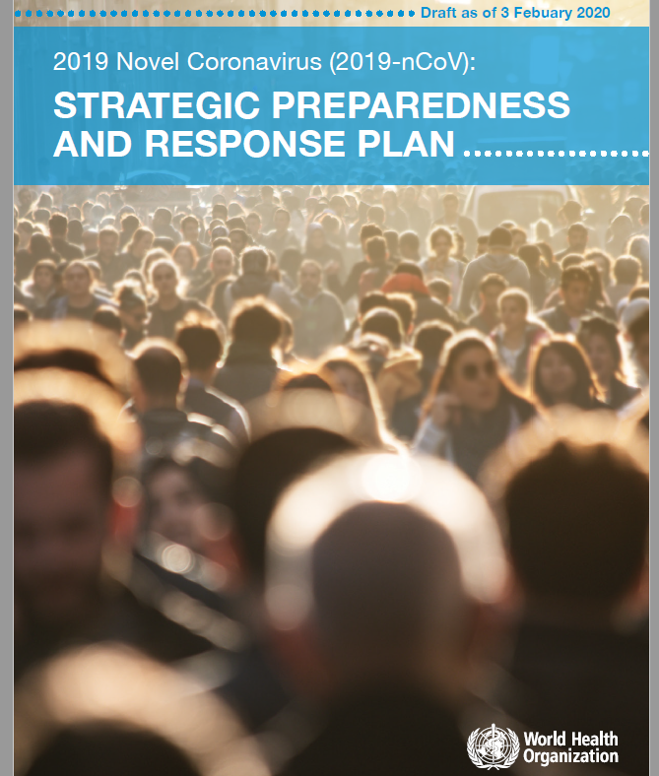



Leadership through global coordination and collaboration
Senior expert mission to the centre of the epidemic in China, through the Global Outbreak Alert and Response Network
Strategic Preparedness & Response Plan developed with key partners, working with UN Country Teams
Activation of UN Crisis Management Policy with critical UN partners
Global Research & Innovation Forum bringing together over 300 research leaders from across the world

Slide 13
2019-nCoV Strategic Preparedness and Response Plan
Scope: Public health strategy to support countries to prepare and respond to nCoV-2019
Goal: To stop further transmission of 2019-nCoV within China and to other countries, and to mitigate the impact of the outbreak in all countries
Strategic objectives:
Limit human-to-human transmission
Identify, isolate and care for patients early
Identify and reduce transmission from the animal source
Address crucial unknowns
Communicate critical risk and event information
Minimize social and economic impact

Slide 14
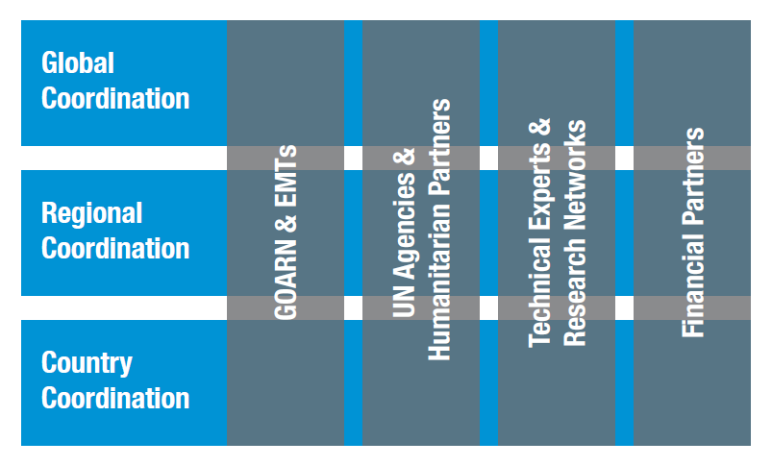
Established global and regional coordination and operational support
Global/Regional support platforms:
Partner coordination
Epidemiological analysis and forecasting
Risk communication
Laboratory and diagnostics
Technical expertise and guidance
Pandemic supply chain coordination
Travel and trade

Slide 15

Scaling country preparedness and response
Country operational planning guidance:
Country-level coordination
Risk communication and community engagement
Surveillance and points of entry
Rapid response teams
National laboratory system
Infection prevention and control
Case management
Logistics and supply management

Slide 16
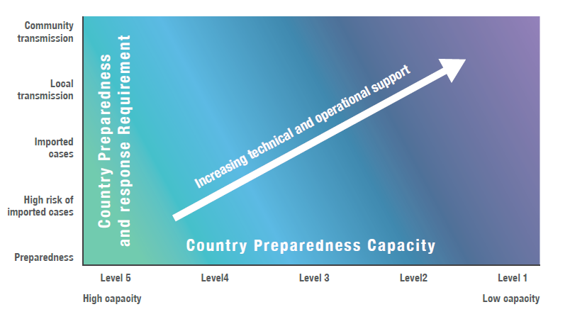
Scaling country preparedness and response
Work with national governments through UNCT to:
Engage with national authorities to identify appropriate coordination mechanism and key technical/operational partners
Map existing preparedness and response capacity and identify key gaps
Engage with national authorities and partners to assign roles and responsibilities to address key gaps
Engage with local donors and existing programmes to mobilize resources and capacities
Establish monitoring mechanisms based on key performance indicators to track progress and adjust the plans as outbreak evolves

Slide 17
Establishment of UN Crisis Management Team
Align whole of UN effort for coherent and coordinated action
Communication of key information
Development of strategies, policy & plans
Analysis & prioritization of key issues
Joint action where synergies exist
Support to country’s
UN coordination, resourcing & oversight
Public health preparedness & response
Assess/address social & economic impact
UN operations
UN staff communication & safety
UN business continuity
Global Issues
Advocacy & resource mobilization
Supply chain monitoring & intervention
Travel, trade & mass gatherings
Global public health
Coordination & technical guidance
Epidemiological analysis & risk communications
Accelerated research & innovation

Slide 18
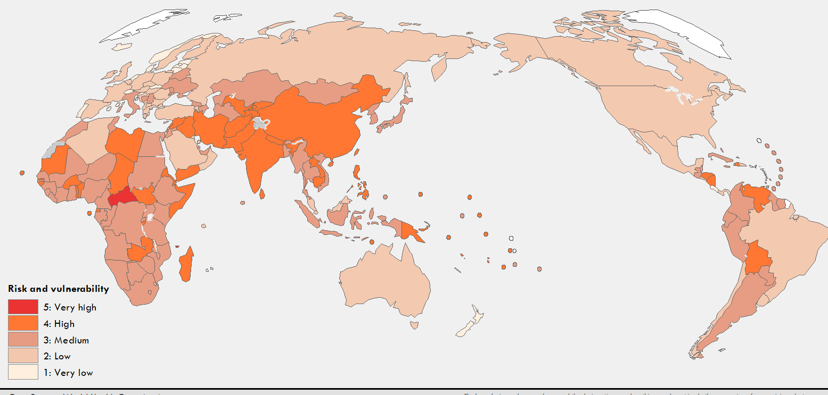
Tracking country risk and vulnerability

Slide 19
Scaling support to countries
Increasing support according to capacity:
Technical guidance & tools
Technical expertise
Supplies & equipment
Training & capacity building
In-country technical & operational support
No regrets support:
Level 5
Current risk
Support Provided
Imported Cases
Local Transmission
Local Transmission
Community Transmission
Level 1

Slide 20
Overall estimated resources required February-April 2020
Strategic preparedness and response pillars | Estimated requirement (USD)
A) Rapidly establishing international coordination and operations | 30,577,500
B) Scaling up country preparedness and response operations | 640,361,927
C) Accelerating priority research and innovation | 4,741,000
Total estimated resource requirement | 675,680,427
Funding status | Funding (USD)
Funding received | 1,188,576
Funding pledged | 209,111,322
Gap | 466,569,105

